Slide 1


How Machine Learning can be used to solve plant biology problems
Christina B. Azodi & Shin-Han Shiu
Michigan State University
Plant Biology 2019, 8/6/19
Notes:
Image credit:
https://www.pinterest.com/pin/292945150756287202/
https://www.pinterest.com/pin/549509592004746347/

Slide 2
Workshop schedule (ML: Machine Learning)
Components | Duration | Details
Introduction | 30 min | What is ML and how does it work?
Discussion 1 | 15 min | What’s interesting and what’s confusing?
Running ML analysis | 35 min | [Eyes-on] How to run a ML analysis?
Discussion 2 | 20 min | How may you apply ML and what data do you need?
Summary | 5 min | What’s the limitation and how about some resources?

Slide 3
Goals of this workshop
At the end of this, you should be able to:
Define ML and basic ML terminology
Identify what kinds of problems that can be solved with ML
Explain how an example ML algorithm works
Describe how a model can be evaluated with a performance measure
Design an overall ML workflow for their own question
Explain to others what the major limitations of ML are

Slide 4

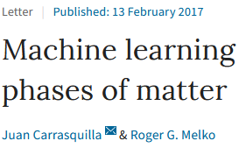
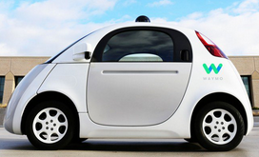
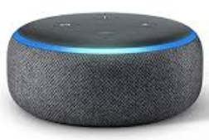
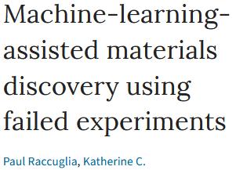
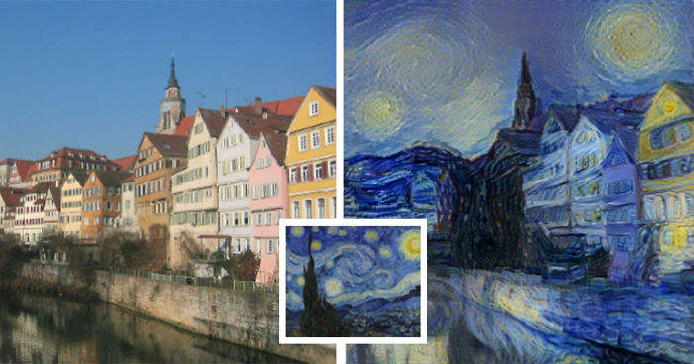
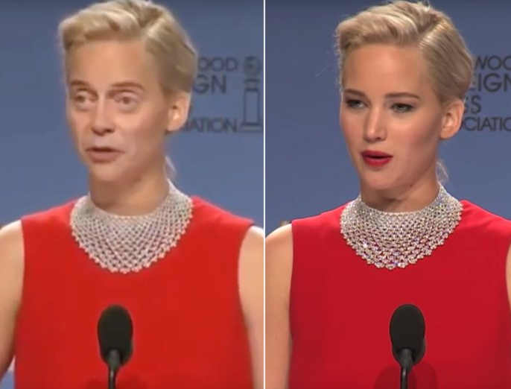
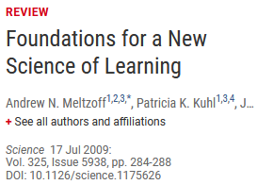

Why ML
As a person
As a scientist
As a biologist
As a plant biologist
ML publications in PubMed as of 8/1/19
Others
(11,257)
Human
(12,956)
Plant (716)
Image credits: in notes
Notes:
Pubmed: “machine learning” 24929
+ plant: 716
+ human: 12956
+ agriculture: 268
+ medical: 6706
Image credits:
https://cdn.technologyreview.com/i/images/waymovehicle1.jpg?sw=959&cx=0&cy=466&cw=3000&ch=1687
https://compostables.org/wp-content/uploads/2018/09/All-new-Echo-Dot-3rd-Gen-Smart-speaker-with-Alexa-Sandstone-0.jpg
https://amp.businessinsider.com/images/5c6d85ca2628986f7f3a5d02-750-563.jpg
https://static.boredpanda.com/blog/wp-content/uploads/2015/08/computer-deep-learning-algorithm-painting-masters-fb__700.jpg
https://media.salon.com/2019/01/facial-recognition2.jpg
https://www.greenmangaming.com/newsroom/wp-content/uploads/2019/07/GooglrDeepMind.jpg

Slide 5

Why ML
Address questions
previously not
answerable or
conceived
So much data! What can we learn and how?
Molecular data
Evolutionary/
ecological data
Assess quantitatively
how much we know
Genomes
Metabolomes
Physiological
measurements
Models
integrating
heterogeneous
info
Provide testable,
mechanistic
hypotheses
Transcriptomes
Morphological
measurements
Proteomes
Methylome
Pinpoint incorrect
info in the data
Environmental
Microbiomes
ML
algorithms
Interactomes
And more…
Can transfer to
relatively data-poor
areas/species
And more…

Slide 6
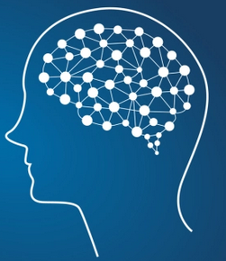
What is ML
Consider how we learn
Tom Mitchell (1997) Machine Learning, 1st ed.
A computer program is said to learn from experience
With respect to a task and a measure of performance,
If its performance improves with experience.
A task, goal, question, or problem
Input: Experiences to learn from
Output:
A model making predictions
Answers
Good
enough?
Knowledge
Yes!
No!

Slide 7






What is ML
Task: Figure out what songs you like so you keep coming back for more
What songs do you like?
Mogwai
The American
dollar
I love you but I have
chosen darkness
Justin B
Song | Like | Mellow rock | Instrumental arrangement | Minor key | Nu-disco qualities | Too good looking | …
1 | Yes | 1 | 1 | 0 | 0 | 0 | …
2 | Yes | 0 | 1 | 1 | 0 | 0 | …
3 | Yes | 0 | 0 | 0 | 0 | 0 | …
4 | No | 1 | 1 | 1 | 1 | 1 | …
… | … | … | … | … |  | … | …
Instances
Labels
Features (1=True, 0=False)

Slide 8
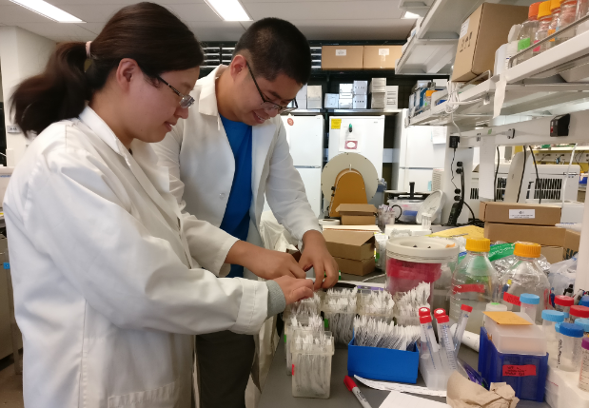
What is ML: from Spotify to Biology
Task: Figure out what songs you like so you keep coming back for more
Song | Like | Mellow rock | Instrumental arrangement | Minor key | Nu-disco qualities | …
1 | Yes | 1 | 1 | 0 | 0 | …
2 | Yes | 0 | 1 | 1 | 0 | …
3 | Yes | 0 | 0 | 0 | 0 | …
4 | No | 1 | 1 | 1 | 1 | …
… | … | … | … | … |  | …
Task: Figure out which genes belong to a particular pathway A
Gene | PWY A | Has domain X | Is expressed under Y | Interact with Z | Induced by W | …
1 | Yes | 1 | 1 | 0 | 0 | …
2 | Yes | 0 | 1 | 1 | 0 | …
3 | Yes | 0 | 0 | 0 | 0 | …
4 | No | 1 | 1 | 1 | 1 | …
… | … | … | … | … |  | …

Slide 9
What kinds of questions can be addressed
Supervised learning
Unsupervised learning
Instances
Labels
Features
Instances
Variables
Gene | PWY A | Expr level | Has domain A | Dev. Defect
1 | YES | 90 | NO | Severe
2 | NO | 85 | NO | Mild
3 | YES | 80 | NO | NO
4 | NO | 70 | YES | NO
5 | NO | 65 | YES | Severe
6 | YES | 60 | NO | Mild
.. | .. | .. | .. | ..
Gene | Expr level | Has domain A | Dev. Defect
1 | 90 | NO | Severe
2 | 85 | NO | Mild
3 | 80 | NO | NO
4 | 70 | YES | NO
5 | 65 | YES | Severe
6 | 60 | NO | Mild
.. | .. | .. | ..
Task: Learn which gene may belong to pathway A
Task: Learn some unspecified patterns from the data

Slide 10
What kinds of questions can be addressed
Which tasks involve supervised learning?
Netflix recommends a movie for customers
Distinguish pictures with dogs and no other animals
Use student data and sort them into groups
Put genes into groups based on many expression experiments
Use genetic information to predict plant height
Labels:
Different
customers
Labels:
Dog vs.
Other animals
Labels:
None
Labels:
None
Labels:
Heights

Slide 11
What kinds of questions can be addressed
Classification
Regression
Instances
Labels
Instances
Labels
Gene | PWY A | Expr level | Has domain A | Dev. Defect
1 | YES | 90 | NO | Severe
2 | NO | 85 | NO | Mild
3 | YES | 80 | NO | NO
4 | NO | 70 | YES | NO
5 | NO | 65 | YES | Severe
6 | YES | 60 | NO | Mild
.. | .. | .. | .. | ..
Gene | PWY A | Expr level | Has domain A | Dev. Defect
1 | YES | 90 | NO | Severe
2 | NO | 85 | NO | Mild
3 | YES | 80 | NO | NO
4 | NO | 70 | YES | NO
5 | NO | 65 | YES | Severe
6 | YES | 60 | NO | Mild
.. | .. | .. | .. | ..
Task: Learn if a gene belong to PWY A
Task: Learn how to predict expression level

Slide 12

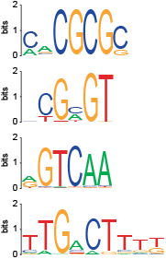
What kinds of questions: example 1
Three examples
Task: Predict which gene is responsive to high salinity stress
Ikke bry meg!
لا يزعجني
邪魔しないで!
Leave me alone!
Pla my nie!
ไม่รำคาญครับ
עזוב אותי
Instances
Labels
Features
Gene | Response | Motif 1 | Motif 2 | ..
1 | Yes | 0 | 1 | ..
2 | No | 1 | 0 | ..
3 | Yes | 0 | 1 | ..
4 | Yes | 1 | 1 | ..
5 | No | 0 | 0 | ..
6 | No | 1 | 0 | ..
.. | .. | .. | .. | ..
別煩我!
मुझे परेशान नहीं करते!
չեն անհանգստացնել ինձ!
Presence
absence
Location
ML algorithms
Responsive
to stress
X
Copy
number
Combina-
tion
Zou et al. (2011) PNAS

Slide 13
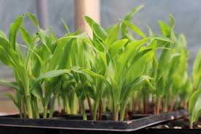
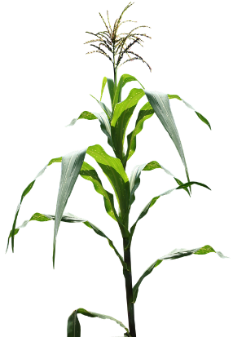
What kinds of questions: example 2
Task: Predict flowering time based on transcriptome variation
Genotype data:
Hirsch et al. (2014) Plant Cell,
genetic markers
Three examples
Question 1:
Are transcriptomes useful for predicting traits, even if the developmental stages differ?
Instances
Labels
Features
Plant | Flowering time | Trans-cript 1 | Trans-cript 2 | ..
1 | 189 | 10 | 6 | ..
2 | 156 | 1024 | 11 | ..
3 | 176 | 23 | 2 | ..
4 | 90 | 56 | 0 | ..
5 | 165 | 865 | 10 | ..
6 | 159 | 1 | 0 | ..
.. | .. | .. | .. | ..
Transcriptomes:
Hirsch et al. (2014) Plant Cell,
Seedling
Question 2:
Do transcriptomes provide different information from genotype data?
Phenotype data:
Flowering time, height, yield
mature plants
Azodi et al. bioRxiv
E-poster: 0300-165
Notes:
Image credit:
https://cdn.pixabay.com/photo/2015/10/22/12/32/maize-field-1001106_960_720.png

Slide 14
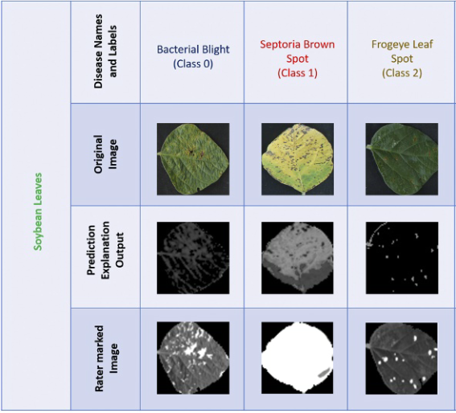
What kinds of questions: example 3
Task: Predict disease based on images
Three examples
Bacterial
blight
(class 1)
Septoria
brown
spot
(class 2)
Forage
leaf
spot
(class 3)
Soybean
leaves
Instances
Labels
Features
Image | Disease
1 | Fungal
2 | Bacterial
3 | Insect
4 | Nutrient
5 | Insect
6 | Bacterial
.. | .. | .. | .. | ..
Original
image
Explanation
output from
predictions
Features are not defined before-hand, but learned by computer!!
Rater
marked
images
Ghosal et al. (2018) PNAS

Slide 15
We will talk about how ML work next…
Before that, any question?

Slide 16

How does ML work
What is the ML workflow?
Input: Experiences to learn from
Output:
answers, predictions
Answers
Good
enough?
No!
https://imgs.xkcd.com/comics/machine_learning.png

Slide 17


How does ML work
Five steps
Step 1:
Identifying problems
Step 2:
Data collection/
cleaning
Step 3:
Feature engineering
Step 4: Model/algorithm selection
Step 5:
Model application/
interpretation
New data
X | ? | …
Y | ? | …
Instances
Label
Features
Gene | Up-reg | Seq1 | Seq2 | …
A | 1 | 1 | 1 | …
B | 1 | 1 | 1 | …
C | 0 | 0 | 0 | …
D | 0 | 0 | 1 | …
… | … | … | … | …
New data
X | 1 | …
Y | 0 | …
Datasets
What questions would you like to ask?
What data should you use?
What features should be used?
Which algorithms and parameters to use?
How should we interpret the results?

Slide 18
WHAT IS YOUR
QUESTION
?

Slide 19
Step 1: Identifying problems
Unsupervised
Classification
Regression
Gene | PWY A | Expr level | Has domain A
1 | YES | 90 | NO
2 | NO | 85 | NO
3 | YES | 80 | NO
4 | NO | 70 | YES
5 | NO | 65 | YES
6 | YES | 60 | NO
.. | .. | .. | ..
Gene | PWY A | Expr level | Has domain A
1 | YES | 90 | NO
2 | NO | 85 | NO
3 | YES | 80 | NO
4 | NO | 70 | YES
5 | NO | 65 | YES
6 | YES | 60 | NO
.. | .. | .. | ..
Gene | PWY A | Expr level | Has domain A
1 | YES | 90 | NO
2 | NO | 85 | NO
3 | YES | 80 | NO
4 | NO | 70 | YES
5 | NO | 65 | YES
6 | YES | 60 | NO
.. | .. | .. | ..
Task:
Find patterns
Task:
Put a categorical label on an instance
Task:
Put a numeric label
on an instance

Slide 20
Step 2 Data collection/cleaning
Step 1:
Identifying problems
Step 2:
Data collection/
cleaning
Step 3:
Feature engineering
Step 4: Model/algorithm selection
Step 5:
Model application/
interpretation
New data
X | ? | …
Y | ? | …
Instances
Label
Features
Gene | Up-reg | Seq1 | Seq2 | …
A | 1 | 1 | 1 | …
B | 1 | 1 | 1 | …
C | 0 | 0 | 0 | …
D | 0 | 0 | 1 | …
… | … | … | … | …
New data
X | 1 | …
Y | 0 | …
Datasets
What questions would you like to ask?
What data should you use?
What features should be used?
Which algorithms and parameters to use?
How should we interpret the results?

Slide 21
Step 2: Data collection/cleaning
Where do the data come from?
Which dataset should we use?
Molecular data
Evolutionary/
ecological data
Task: Predict which gene is responsive to high salinity stress
Genomes
Metabolomes
Physiological
measurements
Transcriptomes
Morphological
measurements
Use data based on what we already know
Use EVERYTHING!
Proteomes
Methylome
Environmental
Microbiomes
Interactomes
And more…
And more…

Slide 22

Step 2: Data collection/cleaning
Data are always not the way you want them to be…
Format
Outlier
Instances
Labels
Data quality
Gene | PWY A | Expr data 1 | Expr data 2 | Has domain A | Dev. Defect
1 | YES | 90 | 10 | NO | Severe
2 | NO | ? | ? | NO | ?
3 | YES | 20 | 18 | ? | NO
4 | NO | 1,234,201 | 2,945 | YES | NO
5 | NO | 15 | 189 | Y | Sevvere
1 | YES | 90 | ? | NO | Mild
6 | MAYBE | 240 | 30 | NO | Mild
.. | .. | .. | .. | .. | ..
Mis-labeled:
Should be Yes!
Missing data
Typo
Duplicate
Irrelevant to the task
Inconsistent value format
Notes:
More information:
https://elitedatascience.com/data-cleaning
https://towardsdatascience.com/the-art-of-cleaning-your-data-b713dbd49726

Slide 23
Step 3 Feature engineering
Step 1:
Identifying problems
Step 2:
Data collection/
cleaning
Step 3:
Feature engineering
Step 4: Model/algorithm selection
Step 5:
Model application/
interpretation
New data
X | ? | …
Y | ? | …
Instances
Label
Features
Gene | Up-reg | Seq1 | Seq2 | …
A | 1 | 1 | 1 | …
B | 1 | 1 | 1 | …
C | 0 | 0 | 0 | …
D | 0 | 0 | 1 | …
… | … | … | … | …
New data
X | 1 | …
Y | 0 | …
Datasets
What questions would you like to ask?
What data should you use?
What features should be used?
Which algorithms and parameters to use?
How should we interpret the results?

Slide 24
Step 3: Feature engineering
LET THE MACHINE DECIDE…
Recall…
What features should be included?
Instances
Labels
Features
Transcriptome
Expert knowledge/
literature
Exp1
Gene | PWY A | Expr level | Has domain A | Dev. Defect
1 | YES | 90 | NO | Severe
2 | NO | 85 | NO | Mild
3 | YES | 80 | NO | NO
4 | NO | 70 | YES | NO
5 | NO | 65 | YES | Severe
6 | YES | 60 | NO | Mild
.. | .. | .. | .. | ..
Exp1
Exp1
Exp1
Exp1
Exp1
Trans-
formation
Exp X
“Raw”
features
“Derived”
features
 | Expression levels
Gene | Exp A | Exp B | Exp C | ..
1 | 13 | 3 | 551 | ..
2 | 343 | 2 | 140 | ..
3 | 21 | 2 | 478 | ..
4 | 1 | 1 | 445 | ..
.. | .. | .. | .. | ..
 | Log10(expr level)
Gene | Exp A | Exp B | Exp C | ..
1 | 1.1 | 0.5 | 2.7 | ..
2 | 2.5 | 0.3 | 2.1 | ..
3 | 1.3 | 0.3 | 2.7 | ..
4 | 0.0 | 0.0 | 2.6 | ..
.. | .. | .. | .. | ..
 | Expr correlation
Gene | 1 | 2 | 3 | ..
1 | 1 | 0.9 | -0.1 | ..
2 | 0.9 | 1 | 0.2 | ..
3 | -0.1 | 0.2 | 1 | ..
4 | 0.3 | 0.4 | 0.3 | ..
.. | .. | .. | .. | ..
Task: Learn which gene may belong to pathway A

Slide 25
Step 3: Feature engineering
Ok, we have tons of features, should we just use all of them?
Why not?
How to select features?
Those with strongest relationships with the labels
 | With domain 1 | Without domain 1
In PWY A | 100 | 0
Not in PWY A | 0 | 30,000
Sometimes…
Some features are not relevant
Some features are redundant
Making prediction with noise
Those with “high importance” in the model
Generated by most ML algorithms
More features
More compli-cated models
Harder to figure out how it works
https://machinelearningmastery.com/an-introduction-to-feature-selection/

Slide 26
Step 4 Model/algorithm selection
Step 1:
Identifying problems
Step 2:
Data collection/
cleaning
Step 3:
Feature engineering
Step 4: Model/algorithm selection
Step 5:
Model application/
interpretation
New data
X | ? | …
Y | ? | …
Instances
Label
Features
Gene | Up-reg | Seq1 | Seq2 | …
A | 1 | 1 | 1 | …
B | 1 | 1 | 1 | …
C | 0 | 0 | 0 | …
D | 0 | 0 | 1 | …
… | … | … | … | …
New data
X | 1 | …
Y | 0 | …
Datasets
What questions would you like to ask?
What data should you use?
What features should be used?
Which algorithms and parameters to use?
How should we interpret the results?

Slide 27
Before we jump into model/algorithm selection…
Any question?

Slide 28
Step 4: Model/algorithm selection
Feature
selection
algorithms
ML
algorithms
Input:
training
instances
all features
Input:
training
instances
Selected
features
Output:
ML
model
Performance
Based on
training
instances
80%
Input:
all instances
all features
Input:
testing
instances
all features
20%
Task:
Predict genes in pathway A
Pathway A |  | Truth
 |  | Is | Is not
Prediction | Is | 25 | 25 | 50%
 | Is not | 25 | 25 | 50%
 |  | 50% | 50%
Pathway A |  | Truth
 |  | Is | Is not
Prediction | Is | 45 | 10 | 82%
 | Is not | 5 | 40 | 89%
 |  | 90% | 80%
Knowing (truth):
50 genes in A
50 genes not in A

Slide 29
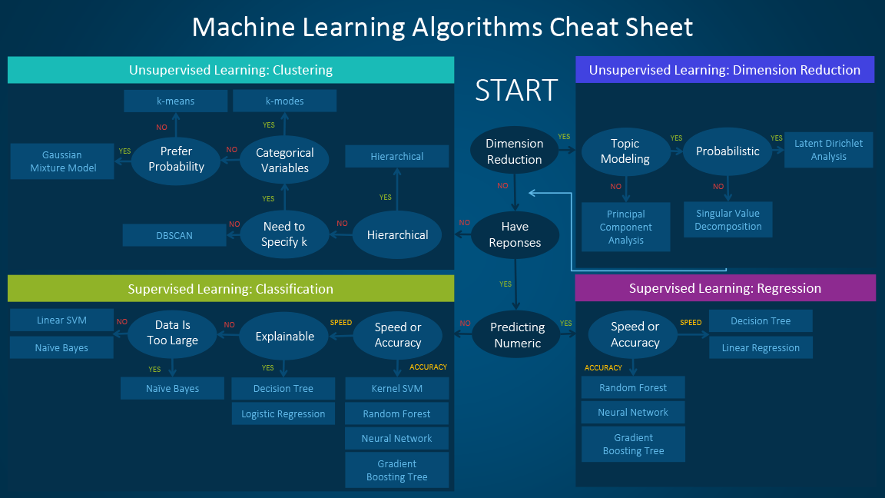
Step 4: Model/algorithm selection
Which algorithms should be used?
Need to try multiple algorithms
Have
labels
https://blogs.sas.com/content/subconsciousmusings/files/2017/04/machine-learning-cheet-sheet.png

Slide 30
Step 4: Model/algorithm selection
How the algorithm work
Decision tree
A genes:5
Non-A genes: 5
Gene | PWY A | Control shoot transcript level | Herbivory root transcript level
1 | YES | 0 | 391
2 | YES | 24 | 111
3 | YES | 40 | 163
4 | YES | 100 | 350
5 | YES | 45 | 23
6 | NO | 290 | 200
7 | NO | 124 | 220
8 | NO | 235 | 120
9 | NO | 7 | 250
10 | NO | 352 | 261
Control shoot
transcript Level
≥102
<102
A genes:0
Non-A genes: 4
A genes:5
Non-A genes: 1
Herbivory root
transcript Level
≥300
<300
Linear
decision boundary
Support vector machine
Non-linear decision boundary
A genes:1
Non-A genes: 0
A genes:3
Non-A genes: 1

Slide 31

Step 4: Model/algorithm selection
ML
algorithms
You don’t just run this once!
Hyperparameter tuning
E.g. Decision tree
Maximum tree depth
Minimum node size
Cross validation
Input:
training
instances
Output:
ML
model
Model
Performance
Based on
training
instances
1
2
3
4
5
6
7
8
9
10
Cross-validation folds
Split
training
data
Model
Input:
training
instances
Training
Set
(90%)
Validation
Set
(90%)
Average model performance
Performance

Slide 32
Step 4: Model/algorithm selection
Pathway A |  | Truth
 |  | Is | Is not
Prediction | Is | 45 | 10 | 82%
 | Is not | 5 | 40 | 89%
 |  | 90% | 80%
Model evaluation with the independent testing set
Feature
selection
ML
algorithms
Input:
training
instances
all features
Input:
training
instances
Selected
features
Output:
ML
model
Model
Performance
Based on
training
instances
90%
Input:
all instances
all features
FINAL
MODEL
Input:
testing
instances
all features
Input:
testing
instances
Selected
features
10%
Pathway A |  | Truth
 |  | Is | Is not
Prediction | Is | 35 | 17 | 67%
 | Is not | 15 | 33 | 69%
 |  | 70% | 66%
Model
Performance
Based on
testing
instances

Slide 33
Step 4: Model/algorithm selection
Pathway A |  | Truth
 |  | Is | Is not
Prediction | Is | 5 | 1 | 83%
 | Is not | 0 | 4 | 100%
 |  | 100% | 80%
Real
data
Random
data
Perfect
data
Model eval
Gene | PWY A | Control shoot transcript level
1 | YES | 0
2 | YES | 24
3 | YES | 40
4 | YES | 100
5 | YES | 45
6 | NO | 290
7 | NO | 124
8 | NO | 235
9 | NO | 7
10 | NO | 400
400
10
10
10
True positive rate
True negative rate
6
3
6
8
Not
A
8
8
7
7
7
4
4
9
Is A
5
5
5
True positive rate
3
6
3
2
2
2
Model: Ability to predict PWY A membership at different thresholds
9
9
4
0
1
1
1
False negative rate (1 - True negative rate)

Slide 34
Step 5 Model application/interpretation
Step 1:
Identifying problems
Step 2:
Data collection/
cleaning
Step 3:
Feature engineering
Step 4: Model/algorithm selection
Step 5:
Model application/
interpretation
New data
X | ? | …
Y | ? | …
Instances
Label
Features
Gene | Up-reg | Seq1 | Seq2 | …
A | 1 | 1 | 1 | …
B | 1 | 1 | 1 | …
C | 0 | 0 | 0 | …
D | 0 | 0 | 1 | …
… | … | … | … | …
New data
X | 1 | …
Y | 0 | …
Datasets
What questions would you like to ask?
What data should you use?
What features should be used?
Which algorithms and parameters to use?
How should we interpret the results?

Slide 35
Step 5: Model application/interpretation
Application on new instances
Feature
selection
ML
algorithms
Input:
training
instances
all features
Input:
training
instances
Selected
features
Output:
ML
model
Model
Performance
Based on
training
instances
90%
Input:
all instances
all features
FINAL
MODEL
Input:
testing
instances
all features
Input:
training
instances
Selected
features
10%
Gene | PWY A | Control shoot transcript level | Herbivory root transcript level
W | ? | 30 | 101
X | ? | 65 | 123
Y | ? | 311 | 249
Z | ? | 127 | 250
Model
Performance
Based on
testing
instances
YES
YES
NO
NO
New
data

Slide 36
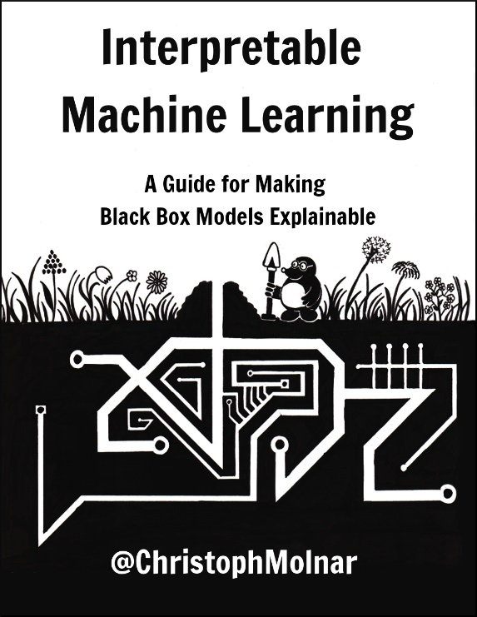
Step 5: model application/interpretation
Interpretation
Decision tree
A genes:5
Non-A genes: 5
If control shoot ≥102:
then not A
else:
if herbivory root ≥300:
then A
else:
75% chance A
Umm…. What??
Control shoot
transcript Level
≥102
<102
A genes:0
Non-A genes: 4
A genes:5
Non-A genes: 1
Herbivory root
transcript Level
≥300
<300
Decision boundary
Support vector machine
Non-linear decision boundary
A genes:1
Non-A genes: 0
A genes:3
Non-A genes: 1

Slide 37
Recap
Step 1:
Identifying problems
Step 2:
Data collection/
cleaning
Step 3:
Feature engineering
Step 4: Model/algorithm selection
Step 5:
Model application/
interpretation
New data
X | ? | …
Y | ? | …
Instances
Label
Features
Gene | Up-reg | Seq1 | Seq2 | …
A | 1 | 1 | 1 | …
B | 1 | 1 | 1 | …
C | 0 | 0 | 0 | …
D | 0 | 0 | 1 | …
… | … | … | … | …
New data
X | 1 | …
Y | 0 | …
Datasets
What questions would you like to ask?
What data should you use?
What features should be used?
Which algorithms and parameters to use?
How should we interpret the results?

Slide 38
Discussion 1
Reflection
(1 min)
Think about how you may answer this:
What one thing do you find the most interesting & what one thing is the most confusing?
Groups of 3-5 (5min)
Share within your group
What's interesting and what's confusing?
For what's confusing, see if you can find solutions within your group.
Whole workshop
(9 min)
Report back!

Slide 39
Next, ML “eyes-on” demo…

Slide 40
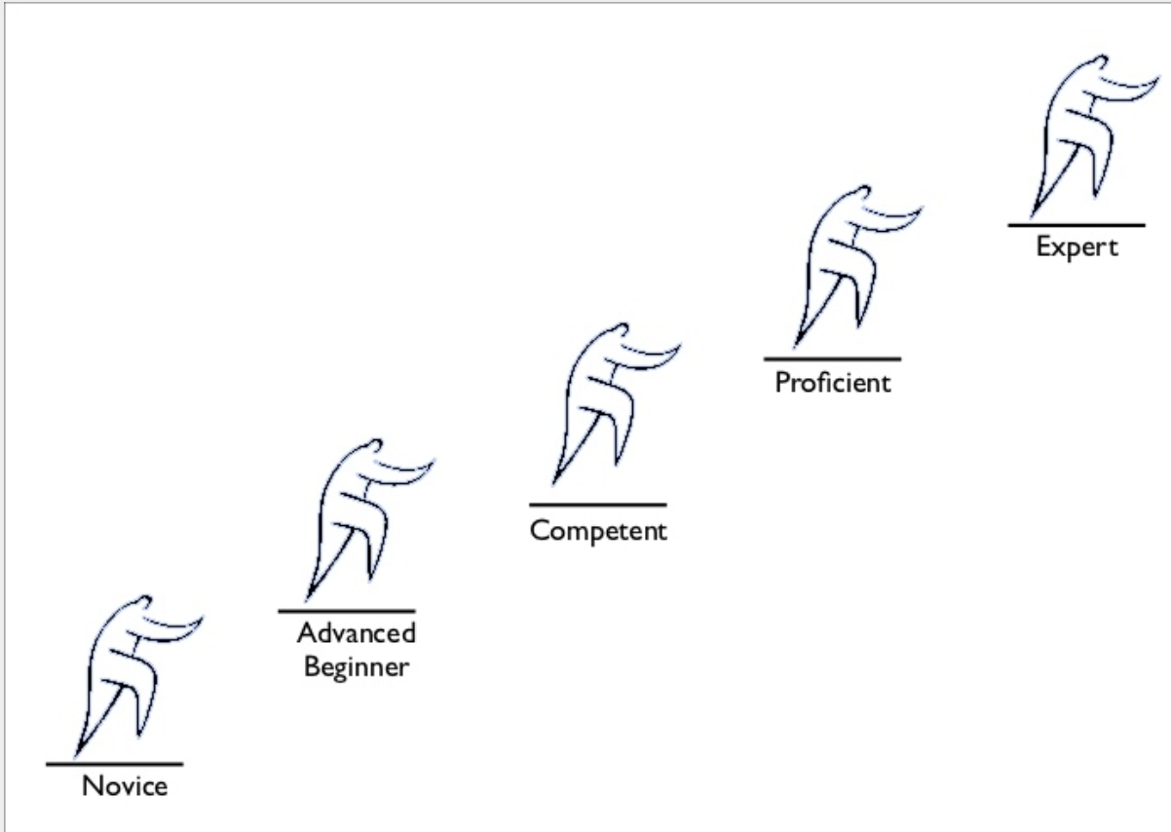
Building ML models
ML is a tool…
Like any tool:
It is not magic
It can be over-hyped
It can be very useful
You can use it wrong
Becoming an expert takes time
Innovate
Implement established methods
Basic troubleshooting
Interpret results
Understand
Collaborate

Slide 41
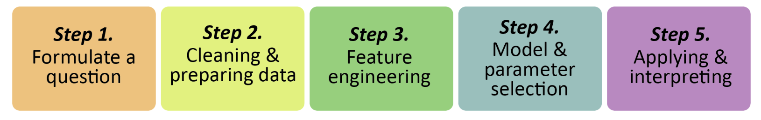
The ML Pipeline
Semi-automated ML workflow for those with minimal to advanced stats & programming skills
https://github.com/ShiuLab/ML-Pipeline

Slide 42
Discussion 2
Reflection
(2 min)
Think about how you may answer this:
What is that one research question you have that may be addressed with ML?
Groups of 3-5
(8 min)
Share within your group
The research question you have come up with.
What kinds of data do you need.
Whole workshop
(10 min)
Report back!

Slide 43

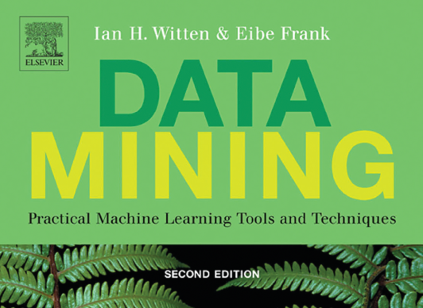

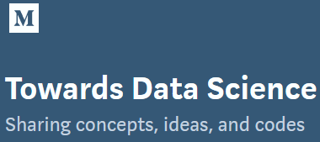
Resources
This workshop
Book
Online course
Blog
ML_Pipeline Workshop on GitHub

Slide 44
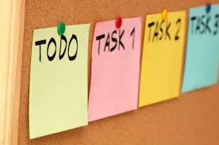

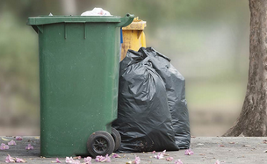


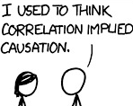
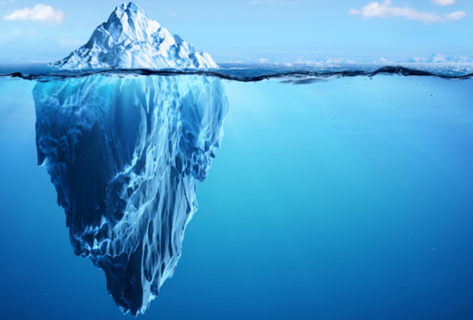
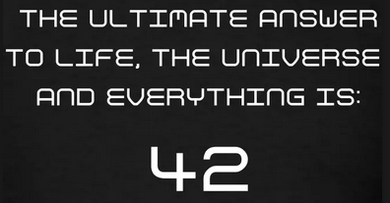
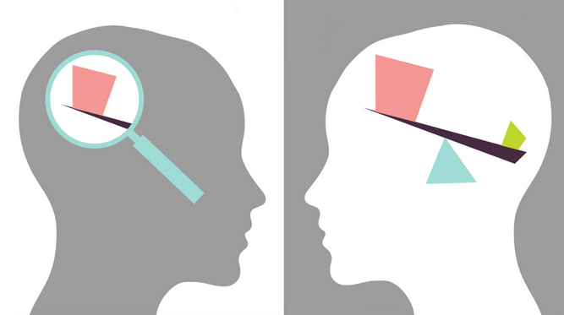
Limitations of ML
Specific model need for each task
High quality & quantity of data
“Here we see that models, despite their reputation for impartiality, reflect goals and ideology. When I removed the possibility of eating Pop-Tarts at every meal, I was imposing my ideology on the meals model. It’s something we do without a second thought. Our own values and desires influence our choices, from the data we choose to collect to the questions we ask. Models are opinions embedded in mathematics.”
Model reusability low
Data label needed
Correlation NOT causation
Hidden variables
Model can be hard to
interpret
Unknown bias in the data
Notes:
Image credit:
https://live.staticflickr.com/2615/4026814703_1e41b03876.jpg
https://upload.wikimedia.org/wikipedia/commons/a/af/Reduce_Reuse_Recycle.jpg
https://discover.rbcroyalbank.com/wp-content/uploads/banner-small-garbage-day_402x-1.jpg
http://intranetfactory.com/content2/image.axd?picture=2010%2F11%2Fistock_000011760242xsmall.jpg
https://image.spreadshirtmedia.com/image-server/v1/compositions/15153709/views/1,width=650,height=650,appearanceId=2,version=1547213188/hitchhikers-guide-42-t-shirt-all-our-hitchhikers-guide-products-are-unique-works-of-art-not-available-commercially-international-shipping-availabl.jpg
https://cdn.iconscout.com/icon/free/png-256/discount-ribbon-tag-label-sale-shop-shopping-1-24561.png
https://cdn.searchenginejournal.com/wp-content/uploads/2017/09/Untitled-design-10-760x400.png
https://www.vision.org/sites/default/files/img/2015fall_checking-the-bias_1920x1080.jpg

Slide 45

Summary
Hype
is promotional publicity that is:
Extravagant <exceeding the limits of reason or necessity>
Or
Contrived <having an unnatural or false appearance or quality> .
Recall our goals
Define ML and basic ML terminology
Identify what kinds of problems that can be solved with ML
Explain how an example ML algorithm works
Describe how a model can be evaluated with a performance measure
Design an overall ML workflow for their own question
Explain to others what the major limitations of ML are
ML is not magic, but it is not just a hype

Slide 46
Thanks for coming…
Before we break, any question?

